Slide 1
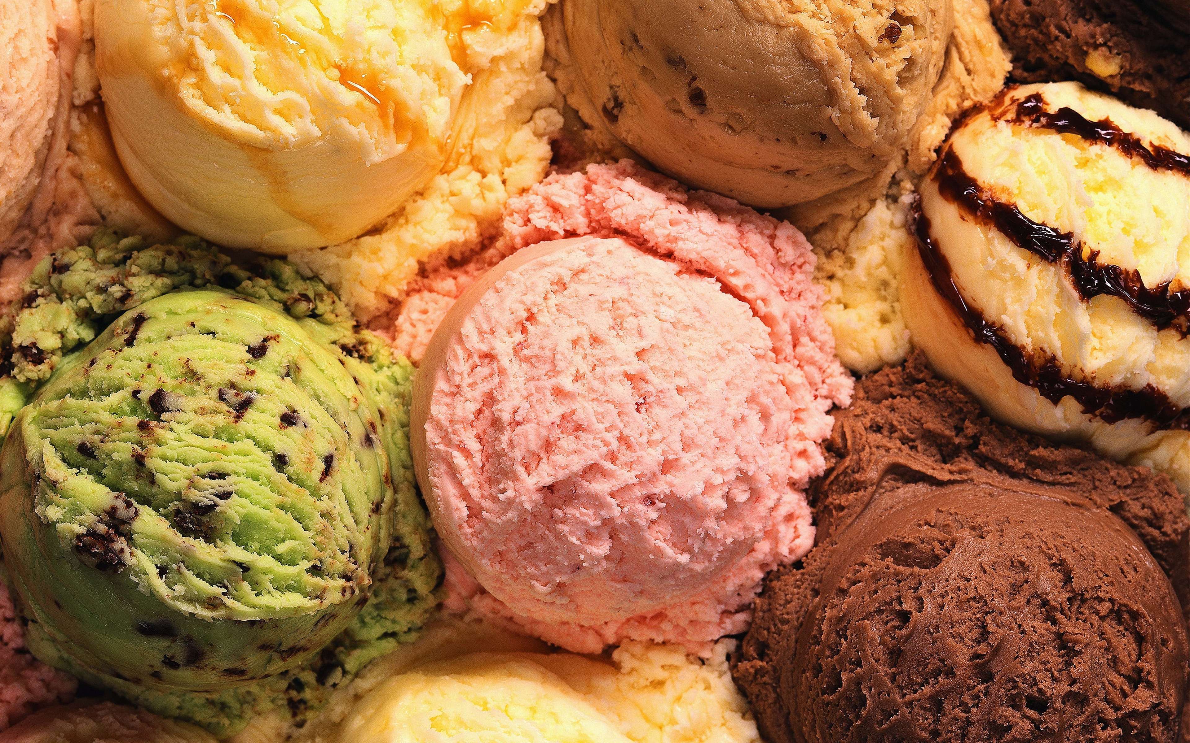
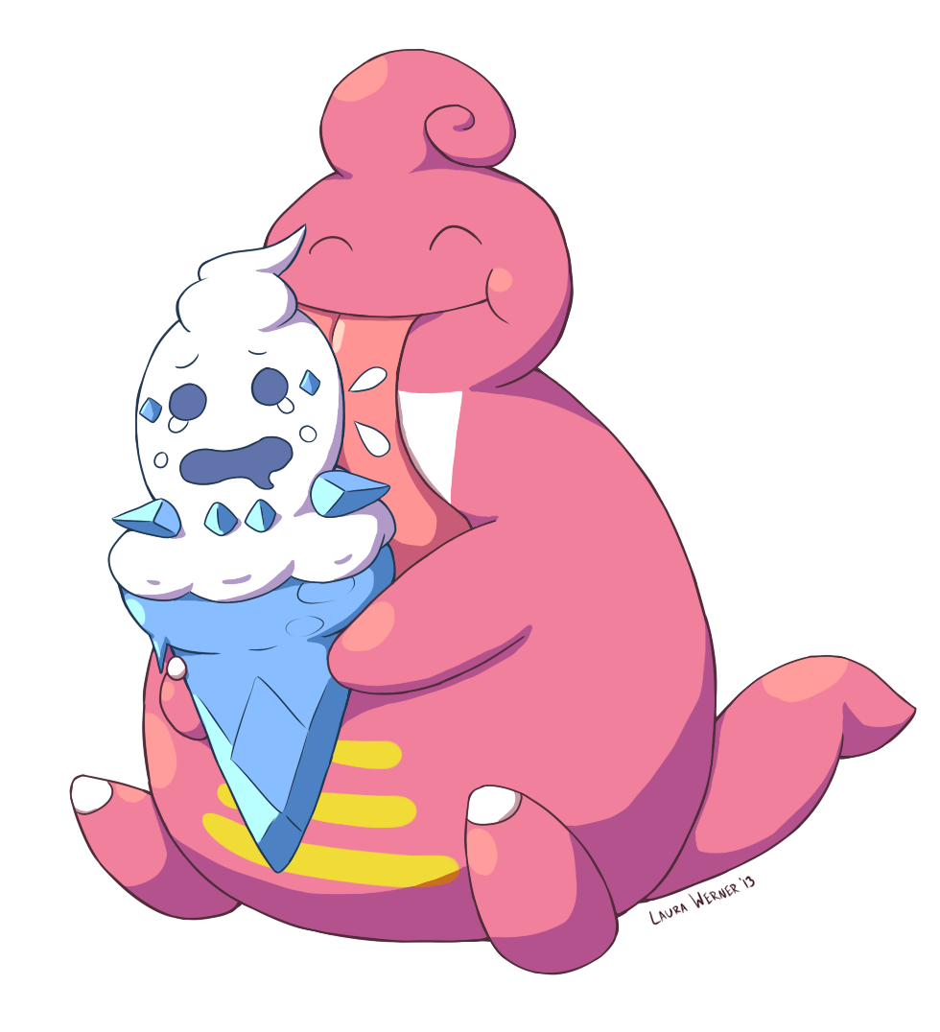
LickiLicky. Inc
Order Management Scenario
Notes:
READ PLEASE!
Before you open this template be sure that you have installed these fonts:
OpenSans-CondLight.ttf from: http://www.fontsquirrel.com/fonts/open-sans-condensed
Titillium-Light.otf from: http://www.fontsquirrel.com/fonts/Titillium
All fonts are free for use in commercial projects!
If you have any problems with this presentation, please contact with me from this page: http://graphicriver.net/user/Bandidos?ref=bandidos
When add image, you must sent it to back! Right Click on Image -> Send to Back -> Send to Back

Slide 2


Outline
1
Business Scenario
EI Concepts
Diagrams
Out of The Labs

Slide 3
Business Scenario
2
Customer places order from LOMS
IM converts state to region
Plant checks and update database
IM mails the invoice & ETA
LOMS sends order to IM
IM performs content-based routing to plant
IM retrieves order ETA
IM informs supplier for possible order restock

Slide 4
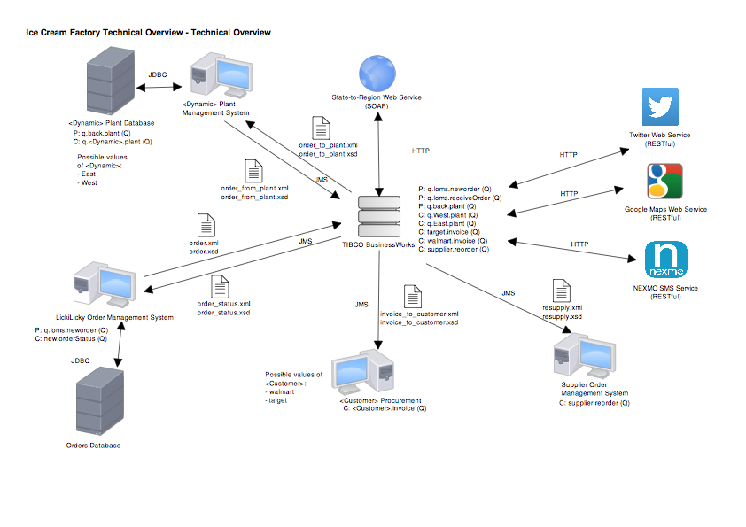
Technical Overview Diagram
3

Slide 5
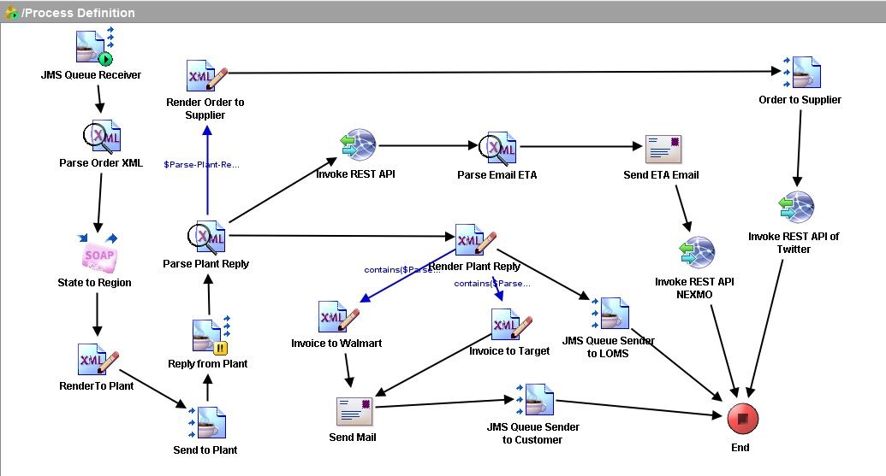
Process Definition Diagram
4

Slide 6


Integration 1
5
TIBCO Business Works
West Plant
LOMS
East Plant

Slide 7
Integration 2
6
TIBCO Business Works
Walmart
LOMS
East Plant

Slide 8
Integration 3
7
TIBCO Business Works
LOMS
Supplier

Slide 9
Content-Based Routing
5
Routing to the east or west plant based on the region
Routing invoice to target or walmart based on the company name

Slide 10



Web Services
6
Twitter Live Tweet API
Nexmo SMS Service
State-to-Region using asp.net
C#
Navigation Google Maps API

Slide 11
Beyond The Labs
Analysis
Payment
Email
Expansion
Sed ut ame perspiciatis unde omnis iste natus error sit voluptatem tam accusantium doloremque rov laudantium, totam rem a aperiam, eaque ipsa quae ab illo inventore veritatis et quasi.
Sed ut ame perspiciatis unde omnis iste natus error sit voluptatem tam accusantium doloremque rov laudantium, totam rem a aperiam, eaque ipsa quae ab illo inventore veritatis et quasi.
By using Tibco Business Work email plugin, emails will be sent to the supplier, walmart / target and plants
Sed ut ame perspiciatis unde omnis iste natus error sit voluptatem tam accusantium doloremque rov laudantium, totam rem a aperiam, eaque ipsa quae ab illo inventore veritatis et quasi.
Notes:
When add image, you must sent it to back! Right Click on Image -> Send to Back -> Send to Back

Slide 12
QUESTION
TIME
Notes:
When add image, you must sent it to back! Right Click on Image -> Send to Back -> Send to Back

